Slide 1
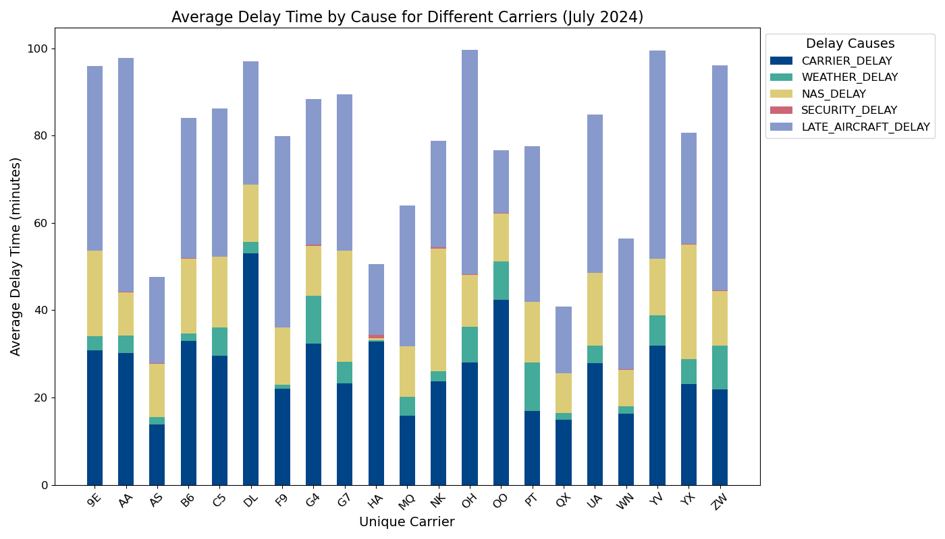
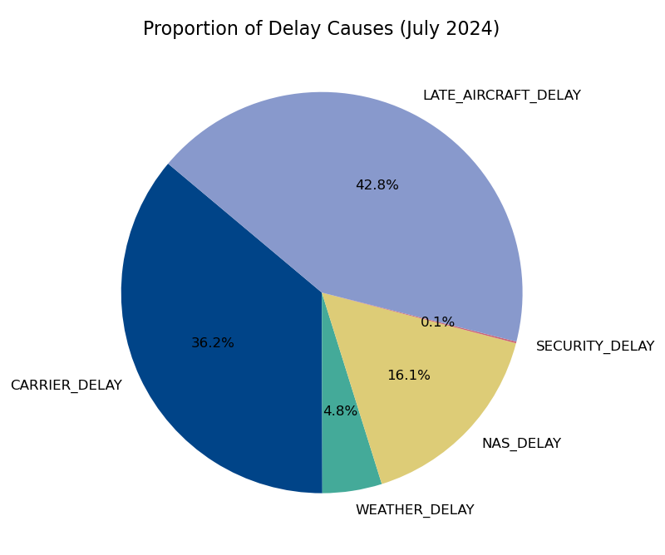
Visualization of flight delays
* Data Source: https://transtats.bts.gov/Fields.asp?gnoyr_VQ=FGK
Notes:
Today, I’ll share the findings of my analysis on flight delays, combining insights from bar and pie charts with an interactive map visualization.
We began by analyzing a dataset of flight delays, calculating the total delay time for each flight. This included delays caused by weather, carriers, the national airspace system, security, and late aircraft.
The bar chart reveals significant variability in delays across different carriers. For instance, carriers like Delta Airlines (DL) show significantly higher Carrier Delays compared to others. This indicates inefficiencies within their operational processes that might need immediate attention.
From the pie chart analysis, it’s clear that Late Aircraft Delays account for a substantial portion of the total delay time. This highlights potential challenges related to scheduling and maintenance practices. In contrast, NAS delays and weather-related delays contribute relatively smaller portions, while security delays are almost negligible. This suggests that systemic and environmental issues are less impactful compared to operational factors.

Slide 2
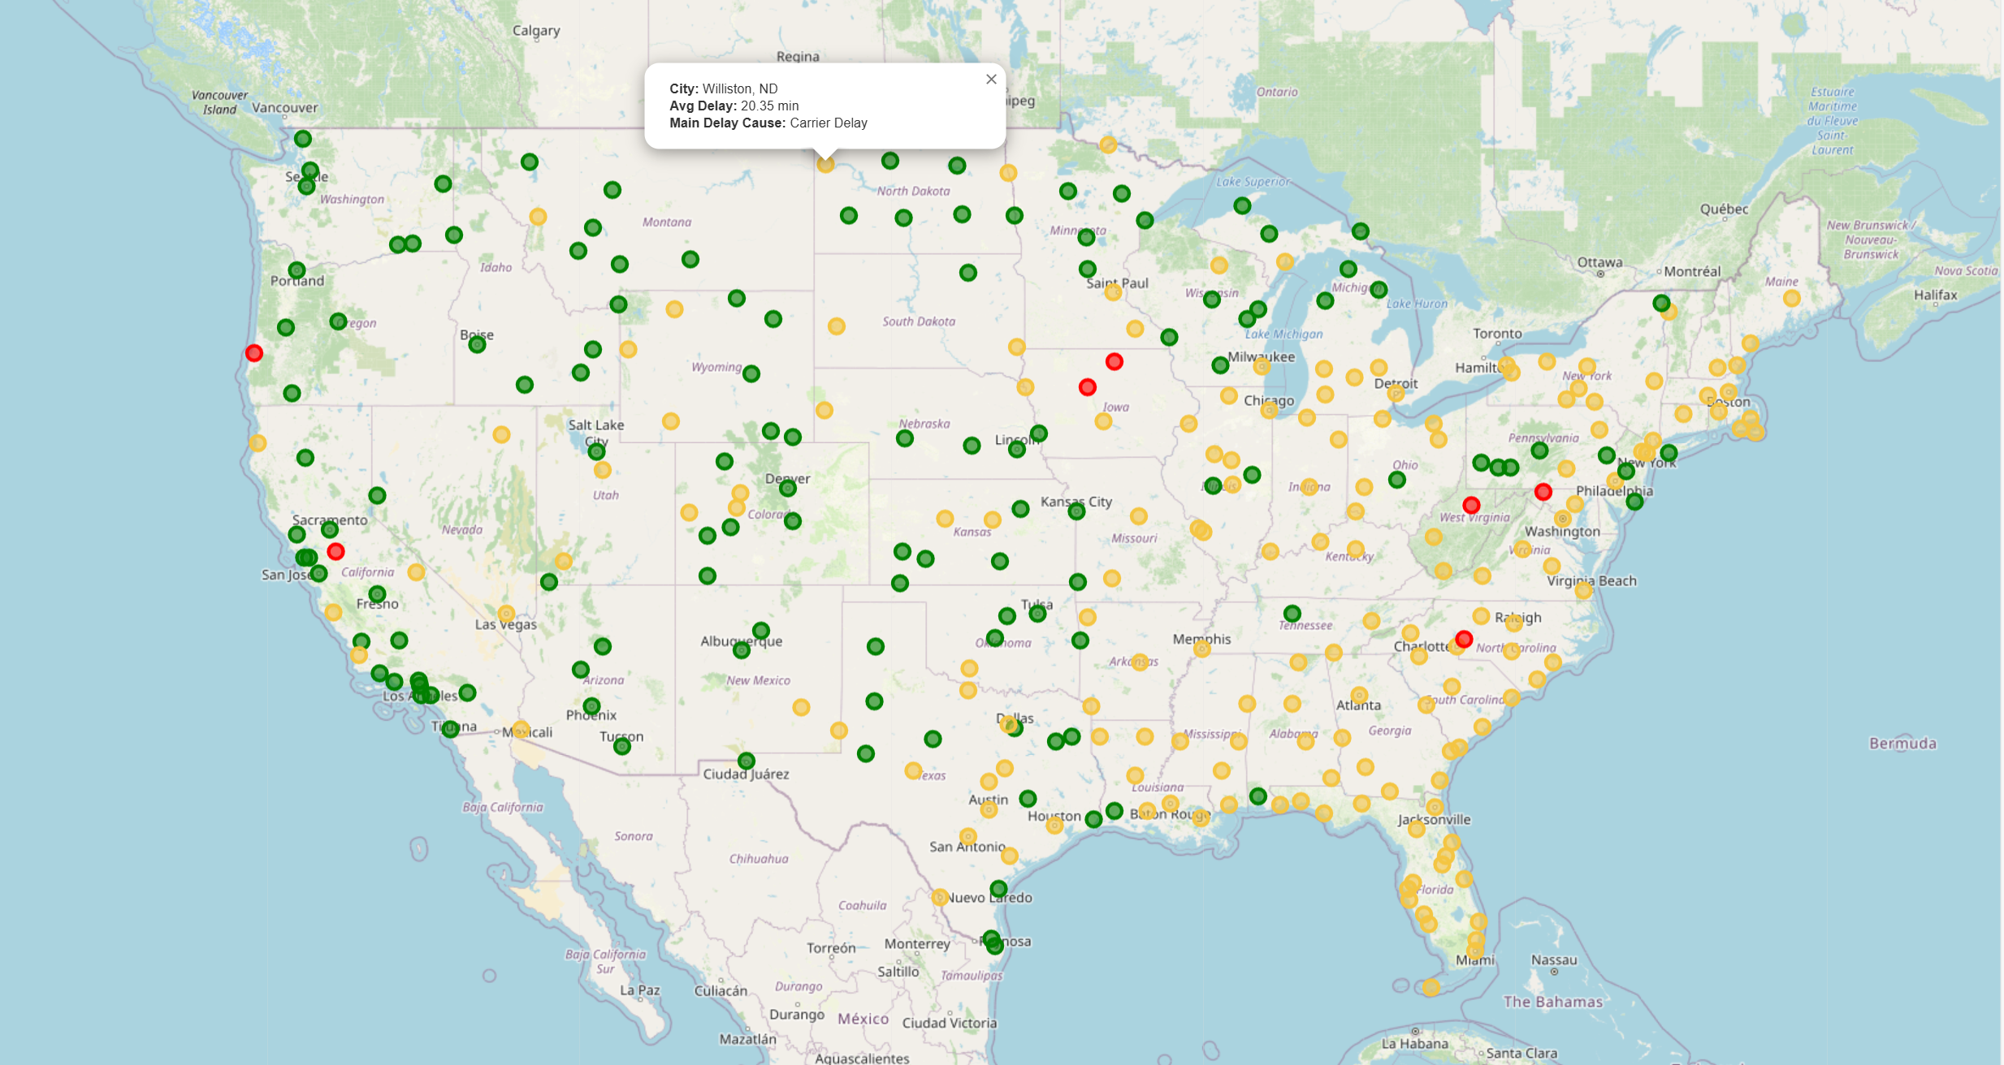
Green<20 minutes, 20 ≤ Yellow ＜ 50 minutes, Red ≥ 50 minutes.
Notes:
Using geographical data of major U.S. cities, we visualized the delays on an interactive map using the Folium library.
Flights were marked on the map with color-coded circles based on delay duration:
Green for delays under 20 minutes,
Yellow for delays between 20 and 50 minutes,
Red for delays exceeding 50 minutes.
Each city marker provides detailed popups, showing the airline and specific delay information.

